Slide 1

Dr.M.TAMILARASI
K.S.RANGASAMY COLLEGE OF TECHNOLOGY
(Autonomous)
Tiruchengode – 637 215, Namakkal (Dt.), Tamil Nadu.
Department of Information Technology
LIVESTOCK MANAGEMENT FOR FARMERS USING ANDROID APPLICATION
Guided by
Present by
KARTHIKEYAN S
MUTHUKUMAR S
ROOPAN RAJ P
Associate Professor
Information Technology
K.S.Rangasamy College of Technology
Tiruchengode – 637 215. Namakkal Dt. Tamil Nadu

Slide 2
INTRODUCTON
The role of our proposed system is to help in solving the problems faced by livestock farmers in day-to-day life so that they can also help the community's economy.
The applications of proposed system will use descriptive methods in gathering data and describing problems that have been faced by the community.
Therefore, this proposed system will be able to reduce the problems faced in the field of animal husbandry.
This application will have various modules which will help livestock farmers in different aspects in the field of animal husbandry and the people with less knowledge in the field will gain more from the proposed solution as the methods will be in the detailed description which will be easy to understand.
The purpose of this proposed system is to produce the necessary information needed by the livestock farmers to handle the problems in the field of animal husbandry using applications that are android based that can help them in various ways.

Slide 3
KEY OBJECTIVES
Providing healthcare tips to people so that they can easily take care of their animals.
Providing better feeding management for domestic animals to increase their productivity and for pet animals to make them grow healthier.
Providing precaution and prevention methods for seasonal diseases.
Providing Buying and Selling (Marketing) Option to users.
Providing better infrastructure based on type of animal.

Slide 4




MODULES
HEALTHCARE
INFRASTRUCTURE
BUYING/SELLING
GOVERNMENT SCHEMES

Slide 5
MODULE 1 :HEALTHCARE
In this Module, the basic and emergency needs for an animal will be satisfied.
This module will be divided into four submodules they are Veterinary Support, HealthCare tips, Seasonal diseases, and Feeding Management.
This module will act upon the type of animal input provided by the user.
Veterinary support submodule will be used for medical and emergency purposes of an animal.

Slide 6
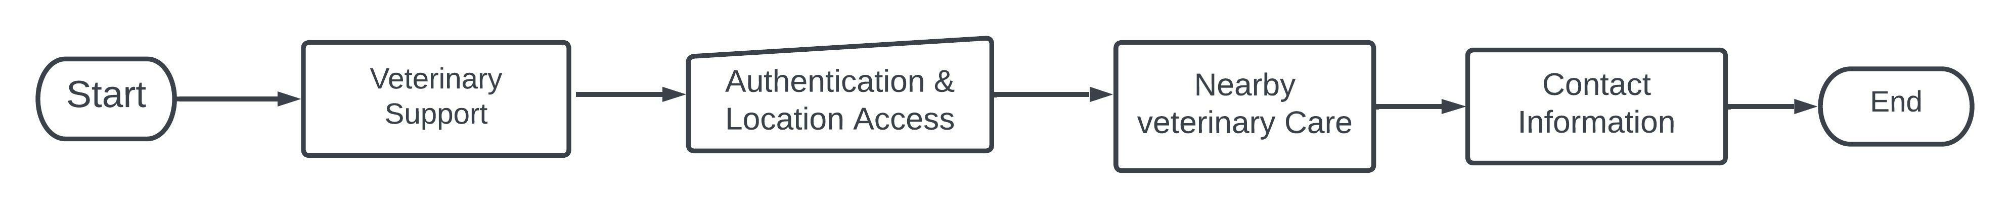
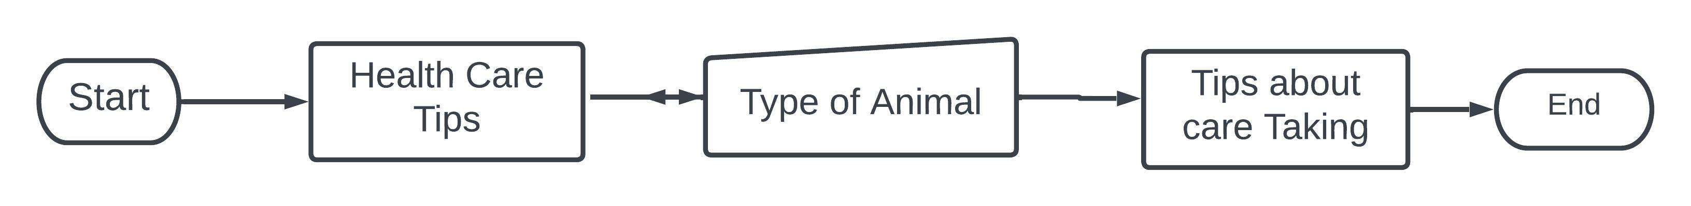
SUB-MODULES OF HEALTHCARE
An Integrated Map will be provided to search for the nearby veterinary care.
HealthCare tips submodule will be used for providing necessary information about the animal.
Information about managing the particular animal will be given in this module.
Seasonal Disease Submodule will be used for disease identification purpose.

Slide 7
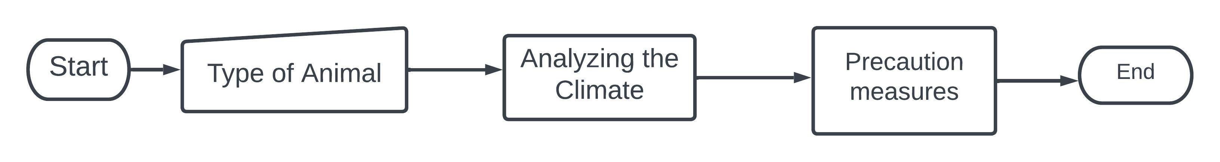
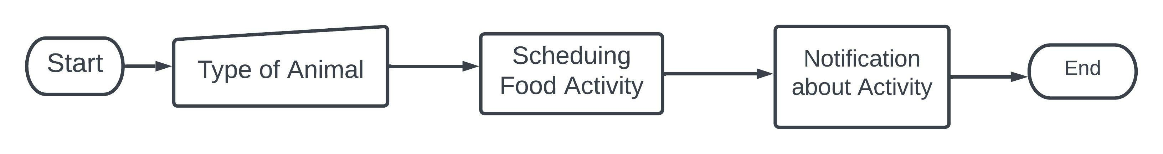
SUB-MODULES OF HEALTHCARE
Weather API will be used to identify the climate of the users location
Scheduling & Time API will be used for notifying the user about feeding activities.
Feeding Management submodule will be used for food purpose.

Slide 8
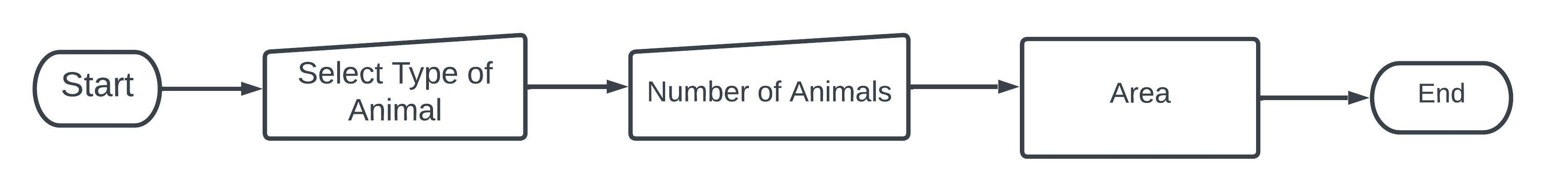
MODULE II : INFRASTRUCTURE
In this Module, the information about the area required for animal shelter will be provided.
It will calculate the area required upon the user’s input animal
A mathematical algorithm will be used to calculate the area of the animal shelter.
Video Guidance will be provide to make the animal shelter.

Slide 9
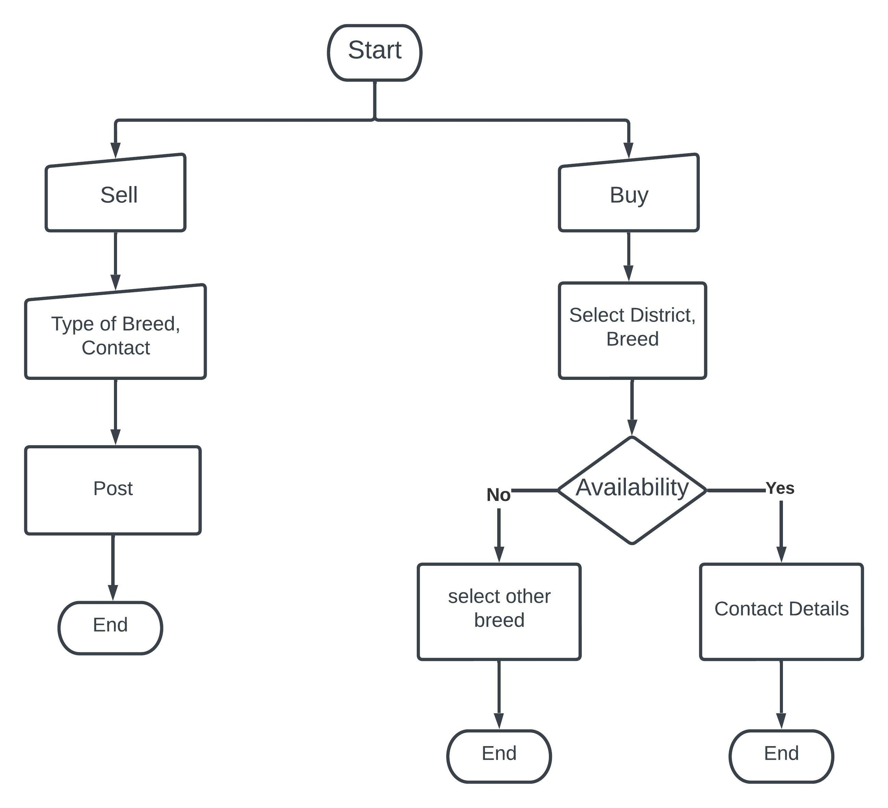
MODULE III: BUYING/SELLING
In this module, the trading of animals between the users will be provided without any brokerage.
The Buyer and sellers information will be provided according to the database.

Slide 10
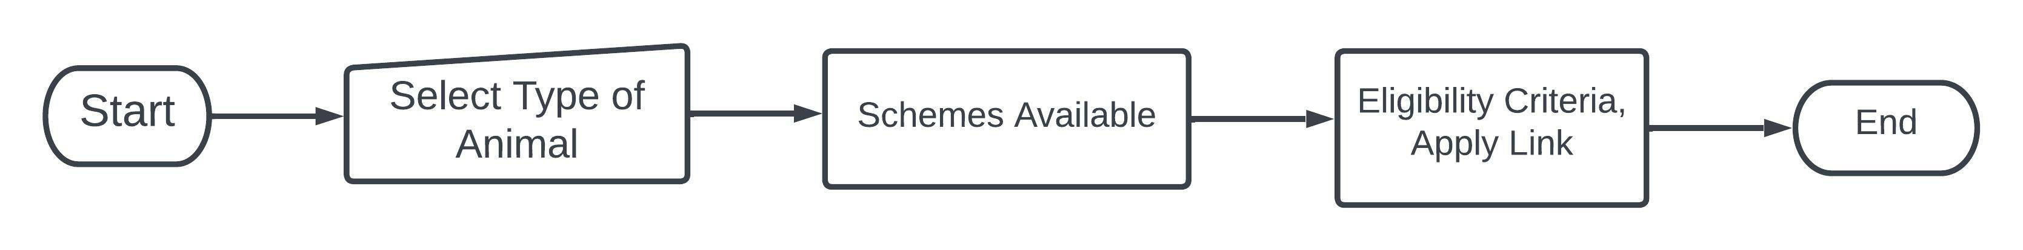
MODULE IV: GOVERNMENT SCHEMES
In this Module, the Schemes provided by the government for the animal will be provided.
The schemes will be provided according to the user’s input.
The information about the Scheme will provided in PDF format.
The Schemes will updated from time to time using Firebase.

Slide 11
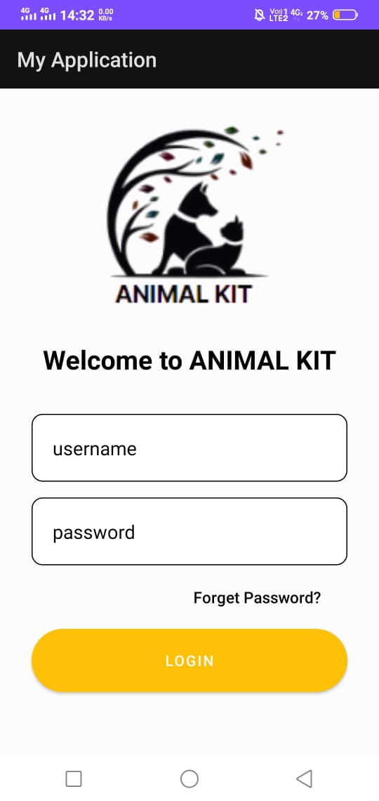
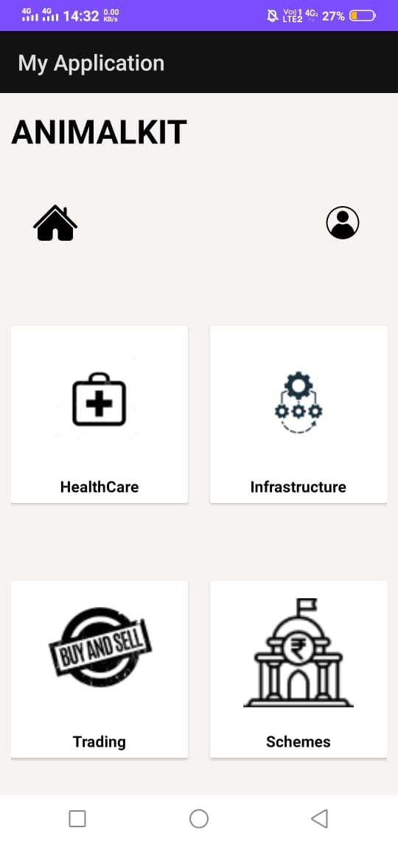
WORK FLOW:

Slide 12
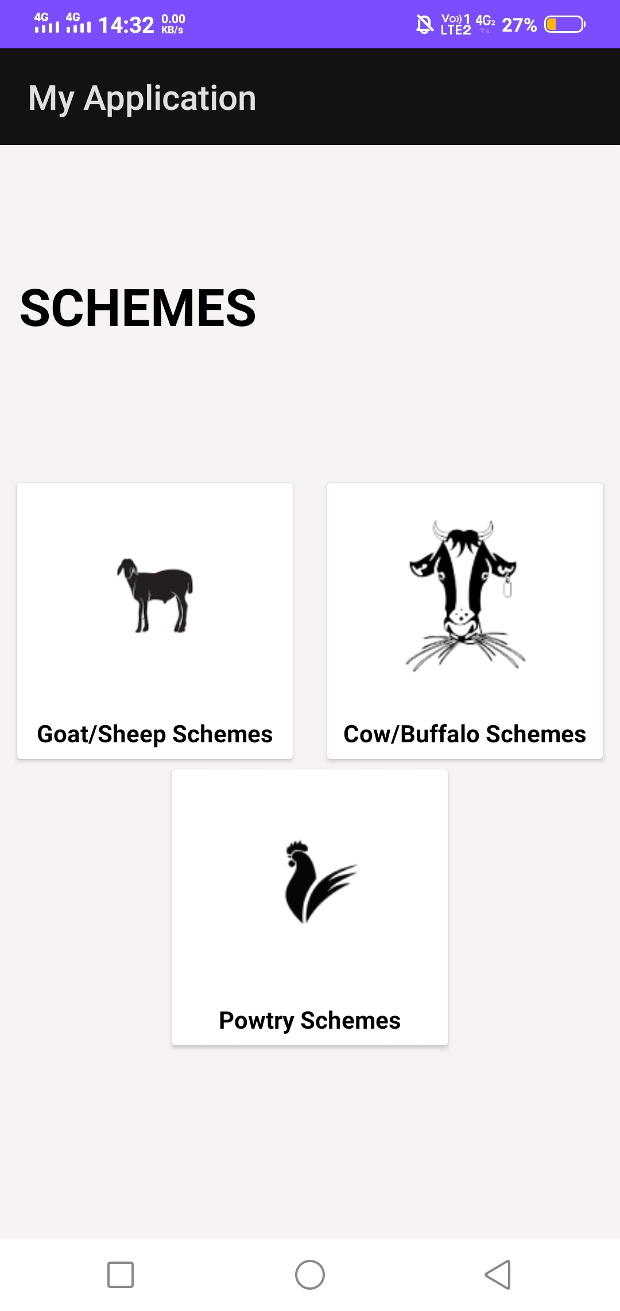
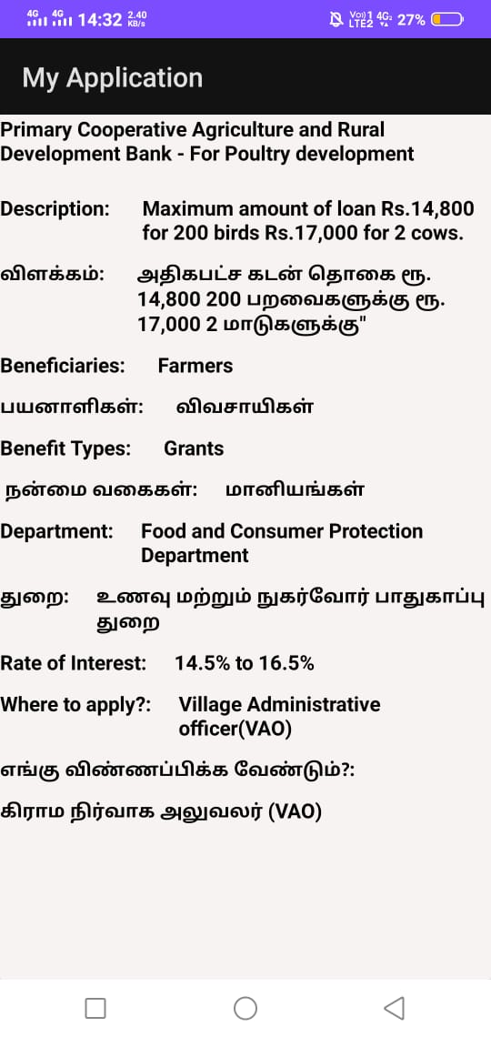
GOVERNMENT SCHEMES: OUTPUT

Slide 13
CONCLUSION
The application will be very useful for livestock farmers as it is developed mainly for the field of animal husbandry.
The benefits gaining from the proposed solution will help the economy of animal husbandry’s field which will result in the improvement of the community.
As the information will be in a detailed descriptive method the less knowledge people entering the field can get adapt to the field easily which will result in the increase in production of the field.
The increase in production will benefit the government various ways which will make the government to give some leverages to the livestock farmers.
Apart from the benefits the knowledge about livestock animals can be gained in a larger level. In the end the proposed system will help the livestock farmers to make their work easier.

